Slide 1

HEART DISEASE PREDICTION Using Machine Learning
-by kanaka

Slide 2

Introduction to Heart Disease Prediction:
In this article, I will take you through how to train a model for the task of heart disease prediction using machine learning. I will use the logistic regression algorithm in machine learning to train a model to predict heart disease.
Predicting and diagnosing heart disease is the biggest challenge in the medical industry and relies on factors such as the physical examination, symptoms and signs of the patient . Thus preventing heart diseases has become more than necessary. Good data-driven systems for predicting heart diseases can improve the entire research and prevention process, making sure that more people can live healthy lives. This is where machine learning comes into play. Machine learning helps in predicting the heart diseases, and the predictions made are quite accurate.

Slide 3
Columns in this Dataset:
age- Age of the patient in years
sex- Gender of the patient (0 = male, 1 = female)
cp- Chest pain type:
0: Typical angina
1: Atypical angina
2: Non-anginal pain
3: Asymptomatic
trestbps- Resting blood pressure in mm Hg
chol- Serum cholesterol in mg/dl
fbs- Fasting blood sugar level, categorized as above 120 mg/dl (1 = true, 0 = false)
restecg- Resting electrocardiographic results:
0: Normal
1: Having ST-T wave abnormality
2: Showing probable or definite left ventricular hypertrophy

Slide 4
thalach- Maximum heart rate achieved during a stress test
exang- Exercise-induced angina (1 = yes, 0 = no)
oldpeak- ST depression induced by exercise relative to rest
slope- Slope of the peak exercise ST segment:
0: Upsloping
1: Flat
2: Downsloping
ca- Number of major vessels (0-4) colored by fluoroscopy
thal- Thalium stress test result:
0: Normal
1: Fixed defect
2: Reversible defect
3: Not described
target- Heart disease status (0 = no disease, 1 = presence of disease

Slide 5
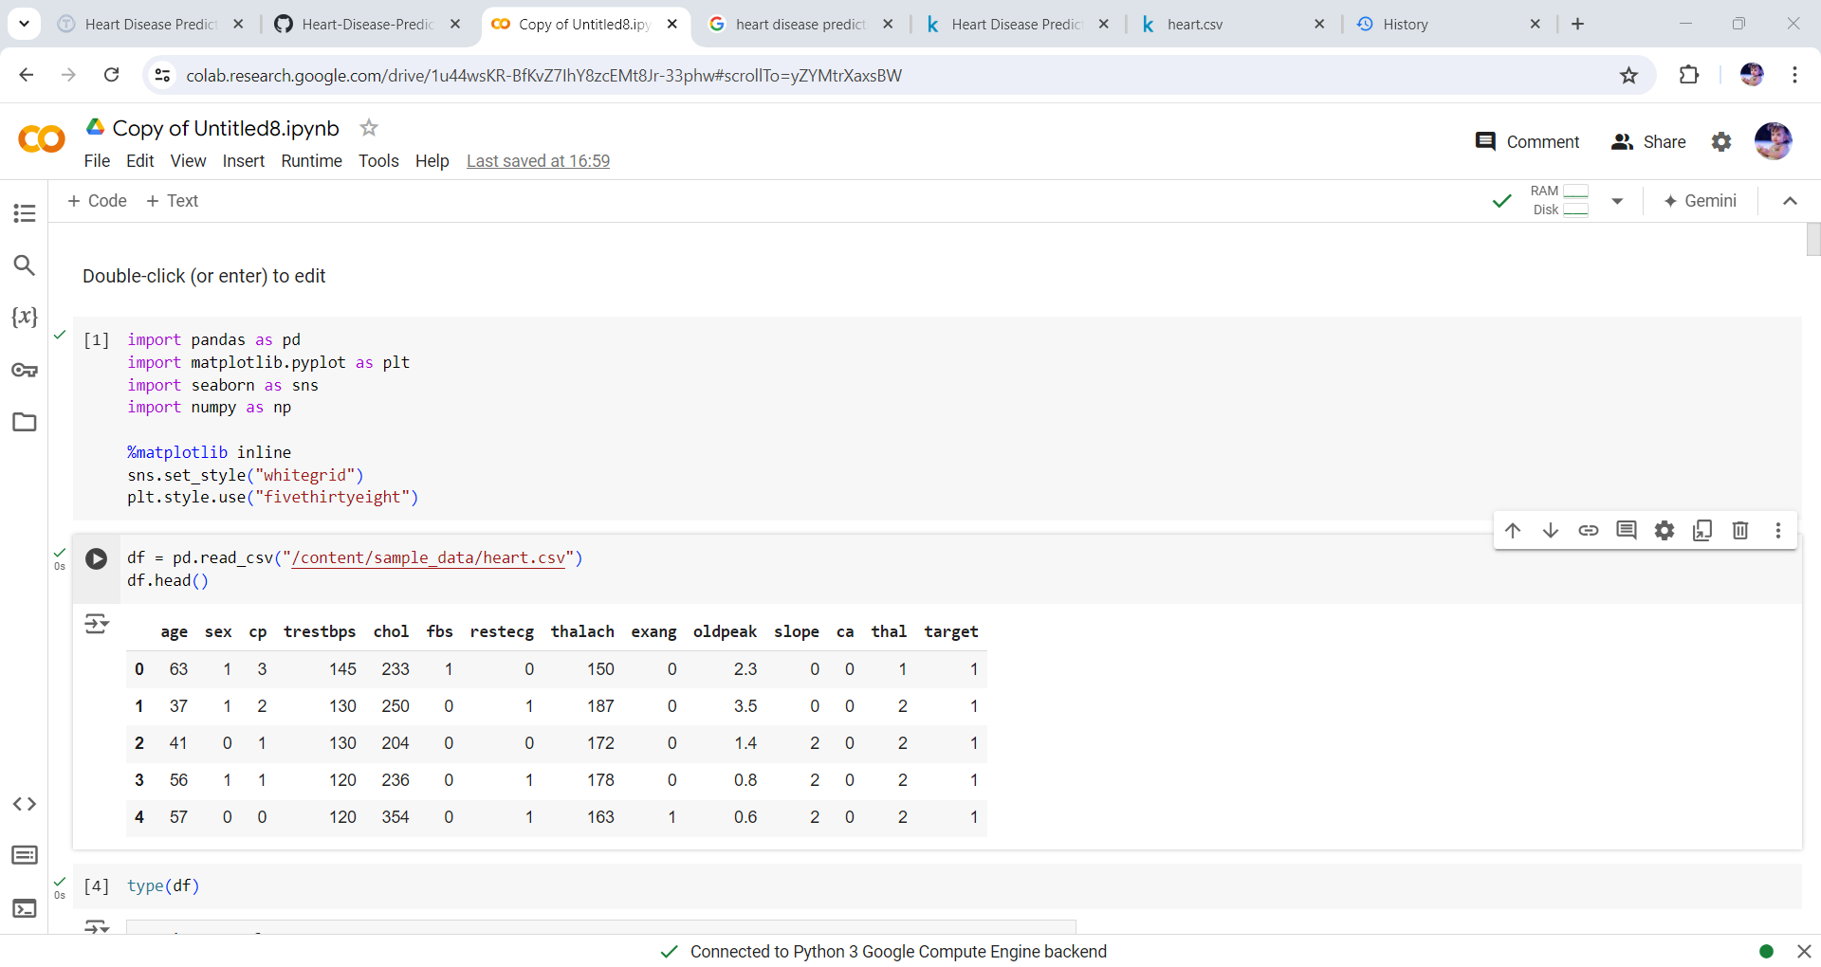
I. Importing essential libraries

Slide 6
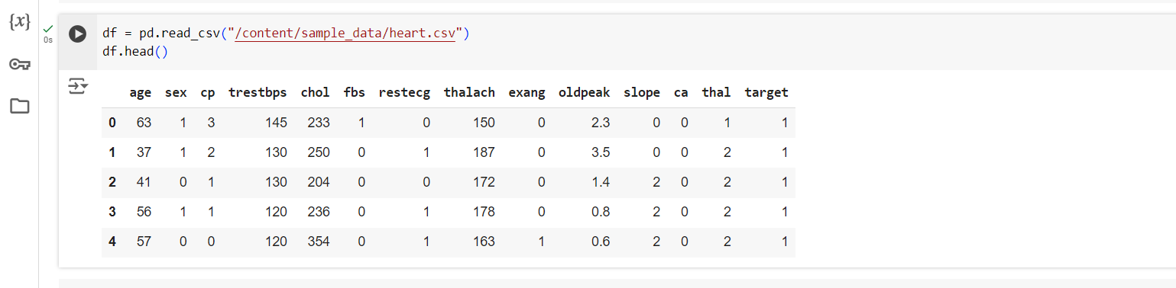
II. Importing and understanding our dataset

Slide 7
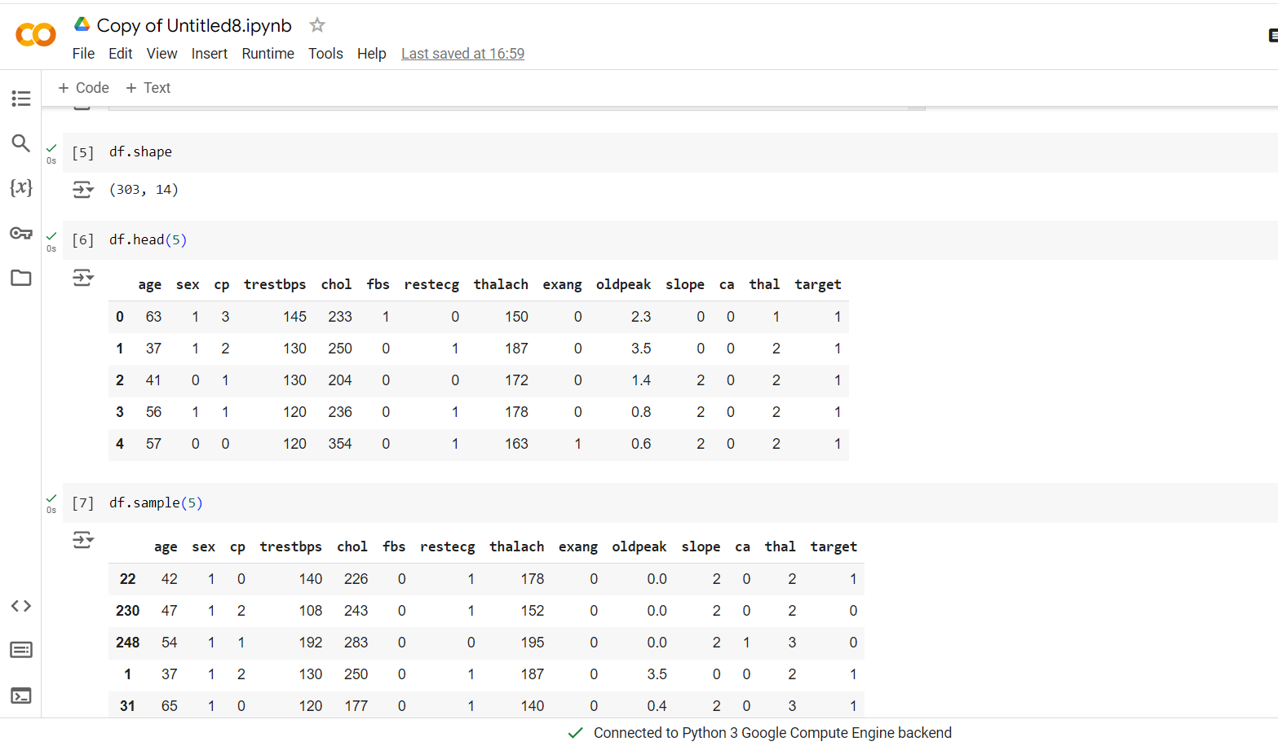
Exploring data

Slide 8
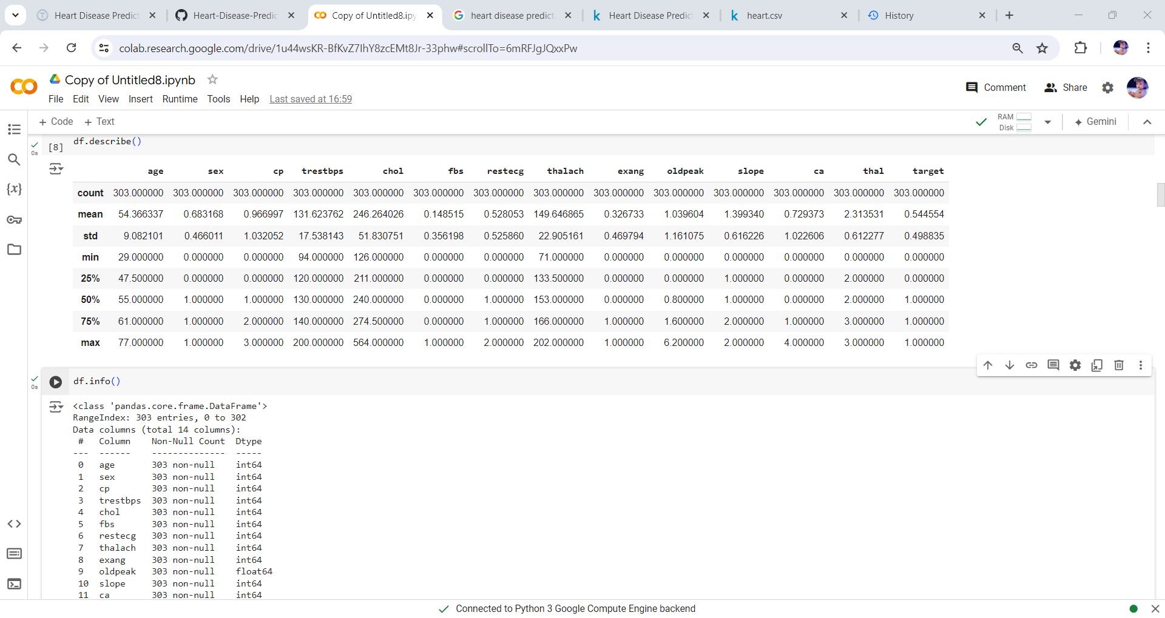

Slide 9
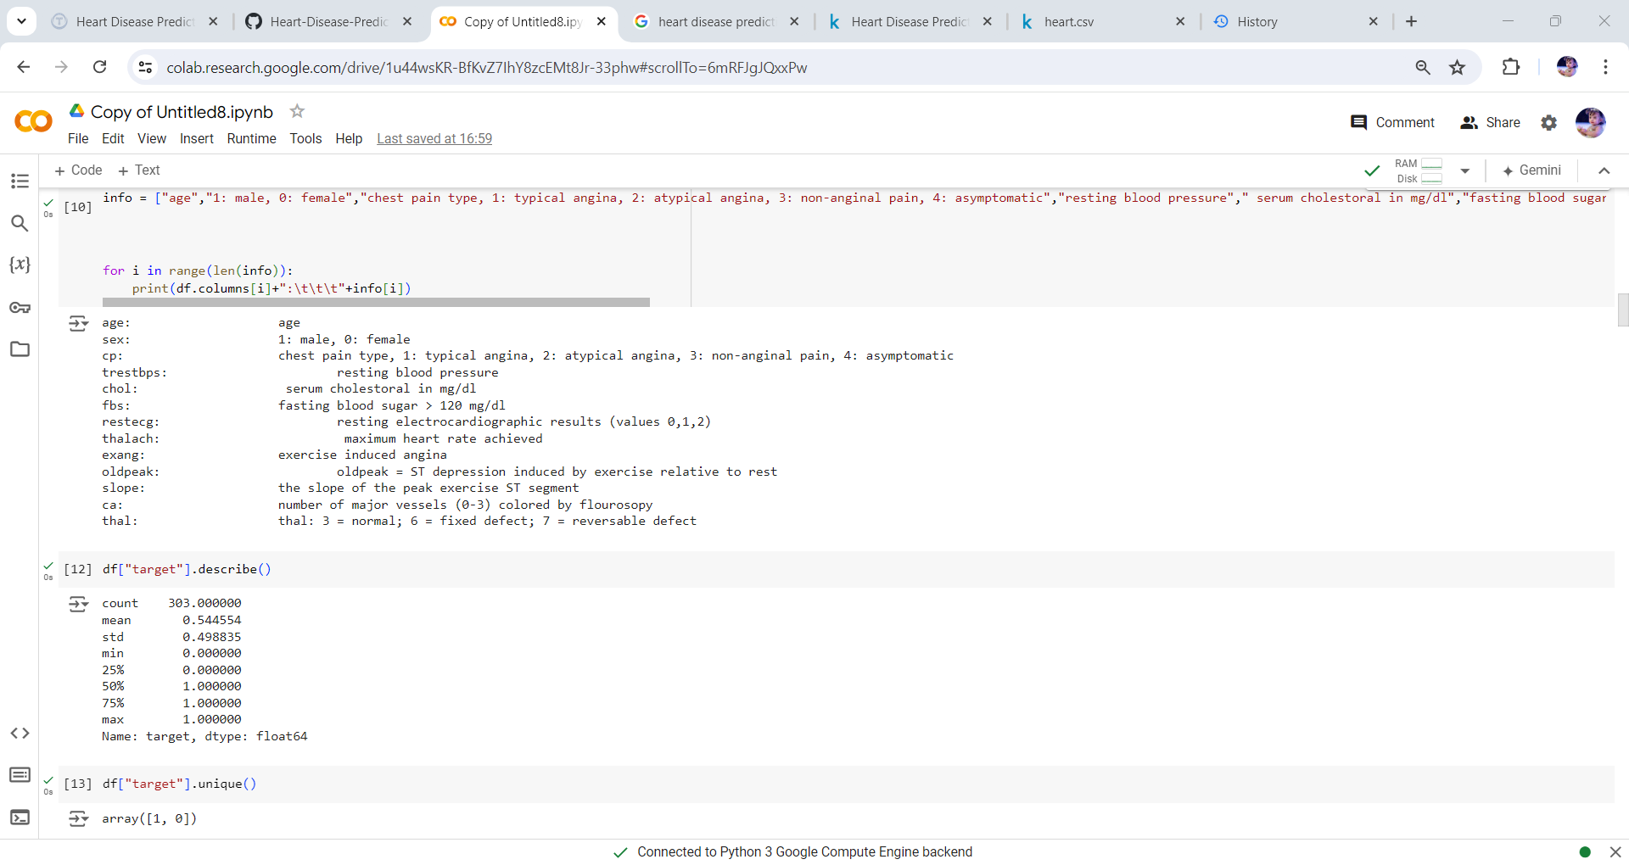

Slide 10
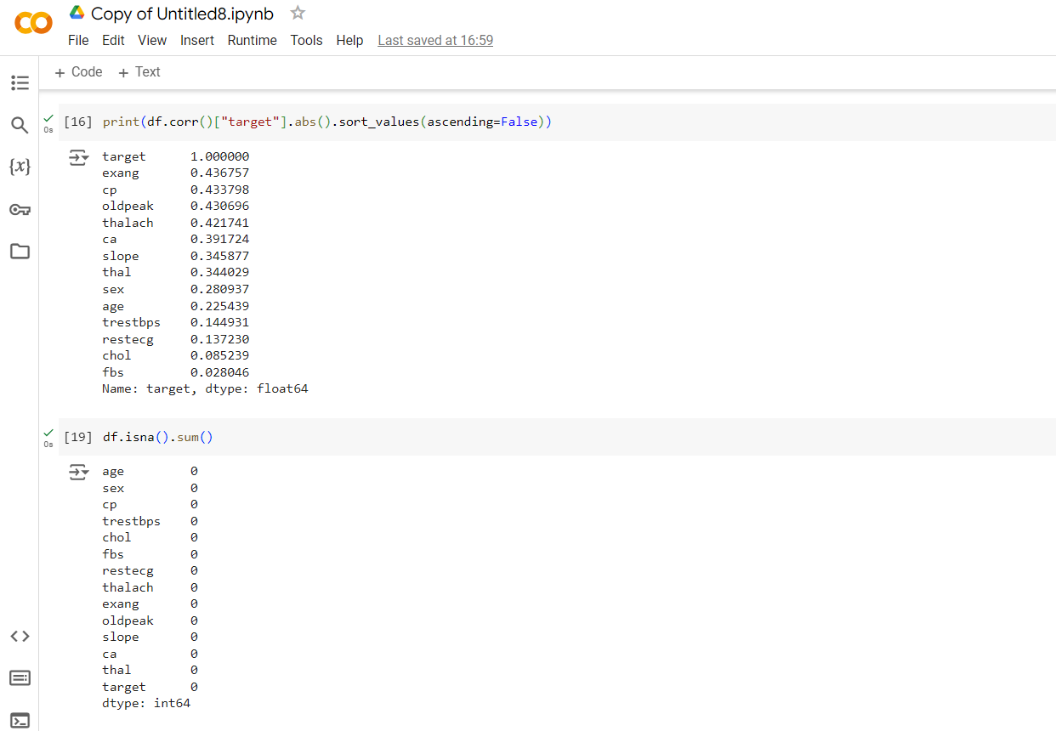
Missing Values

Slide 11
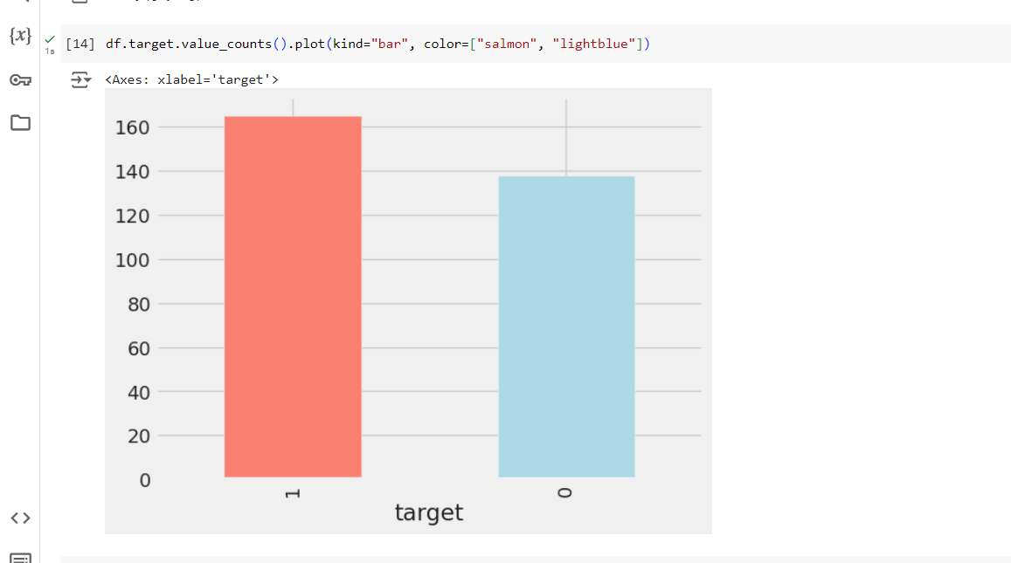
We have 165 people with heart disease and 138 people without heart disease, so our problem is balanced.

Slide 12
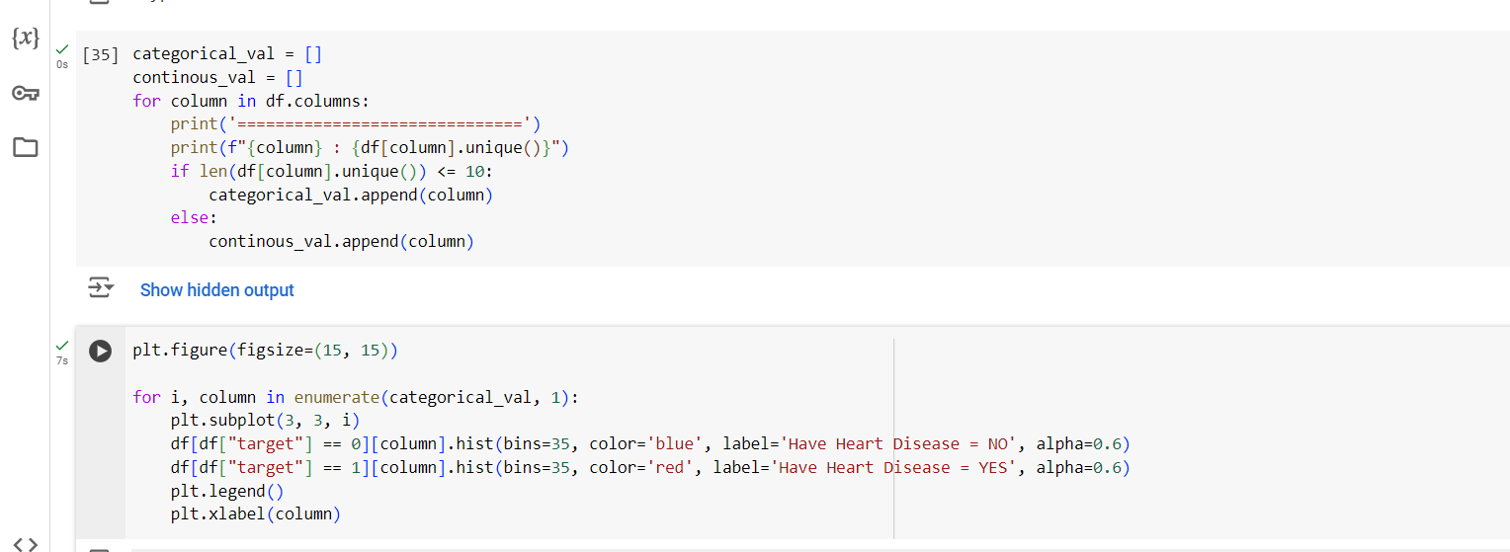

Slide 13
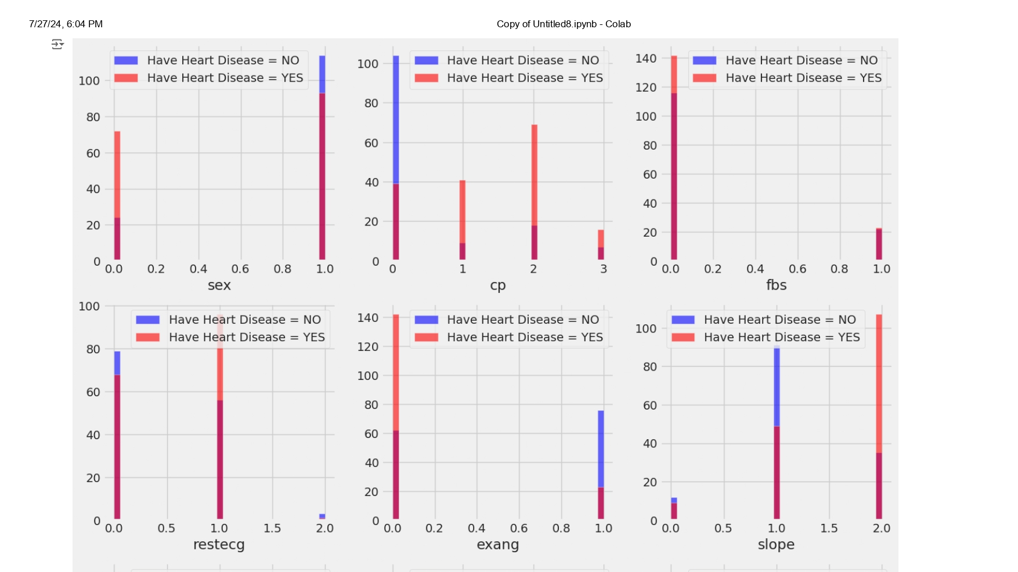

Slide 14
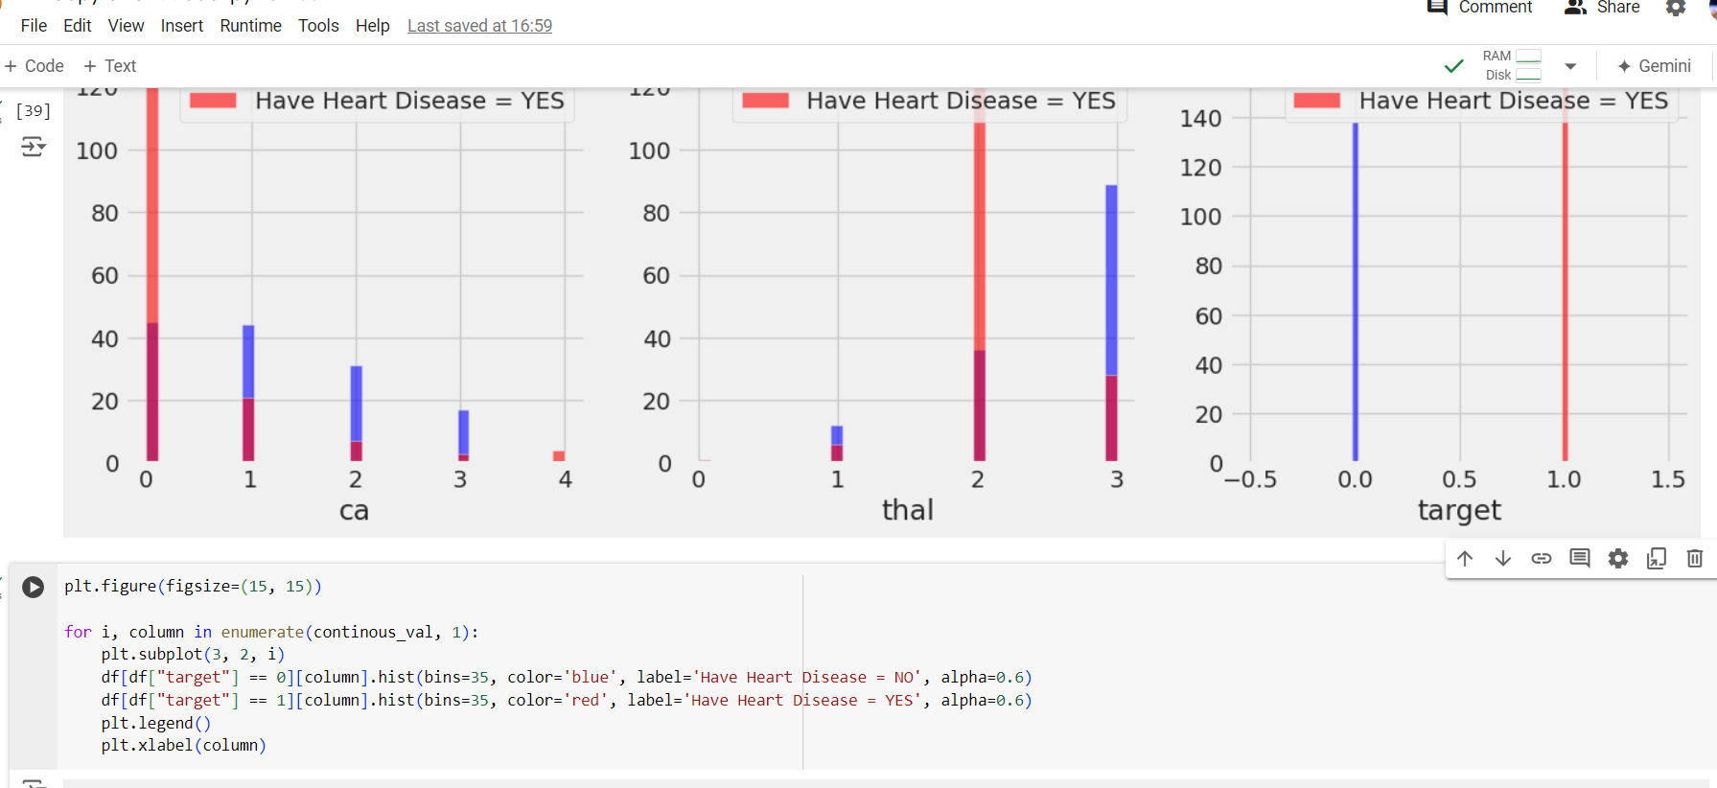

Slide 15
Observations from the above plot:
cp {Chest pain}: People with cp 1, 2, 3 are more likely to have heart disease than people with cp 0.
restecg {resting EKG results}: People with a value of 1 (reporting an abnormal heart rhythm, which can range from mild symptoms to severe problems) are more likely to have heart disease.
exang {exercise-induced angina}: people with a value of 0 (No ==> angina induced by exercise) have more heart disease than people with a value of 1 (Yes ==> angina induced by exercise)
slope {the slope of the ST segment of peak exercise}: People with a slope value of 2 (Downslopins: signs of an unhealthy heart) are more likely to have heart disease than people with a slope value of 2 slope is 0 (Upsloping: best heart rate with exercise) or 1 (Flatsloping: minimal change (typical healthy heart)).
ca {number of major vessels (0-3) stained by fluoroscopy}: the more blood movement the better, so people with ca equal to 0 are more likely to have heart disease.
thal {thalium stress result}: People with a thal value of 2 (defect corrected: once was a defect but ok now) are more likely to have heart disease.

Slide 16
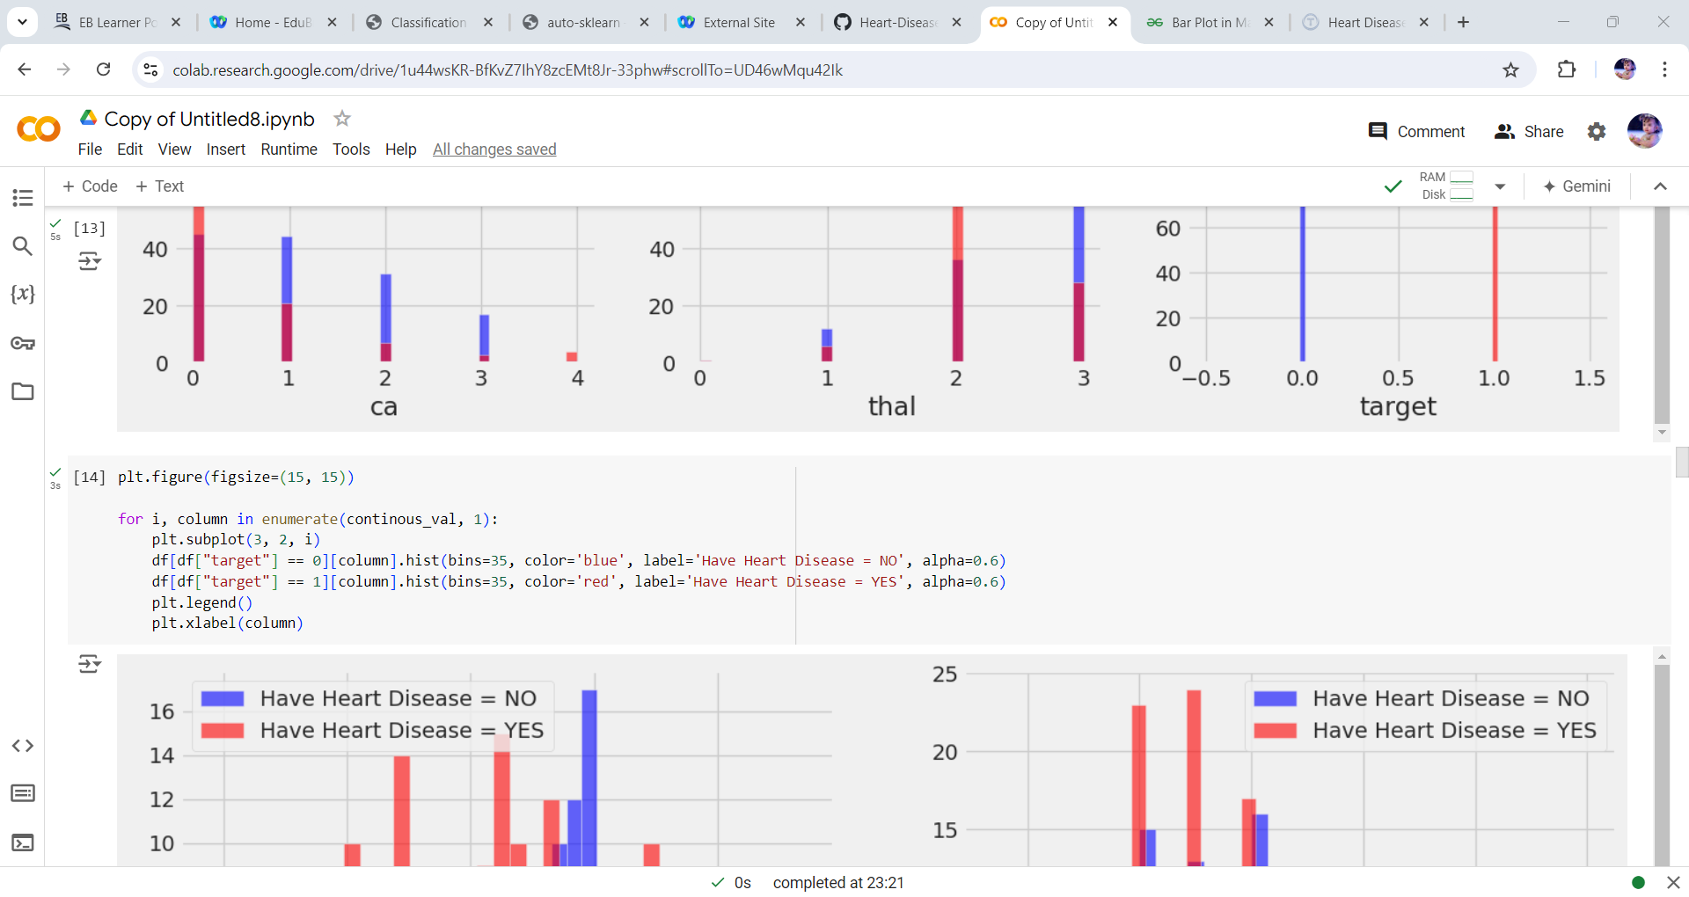

Slide 17
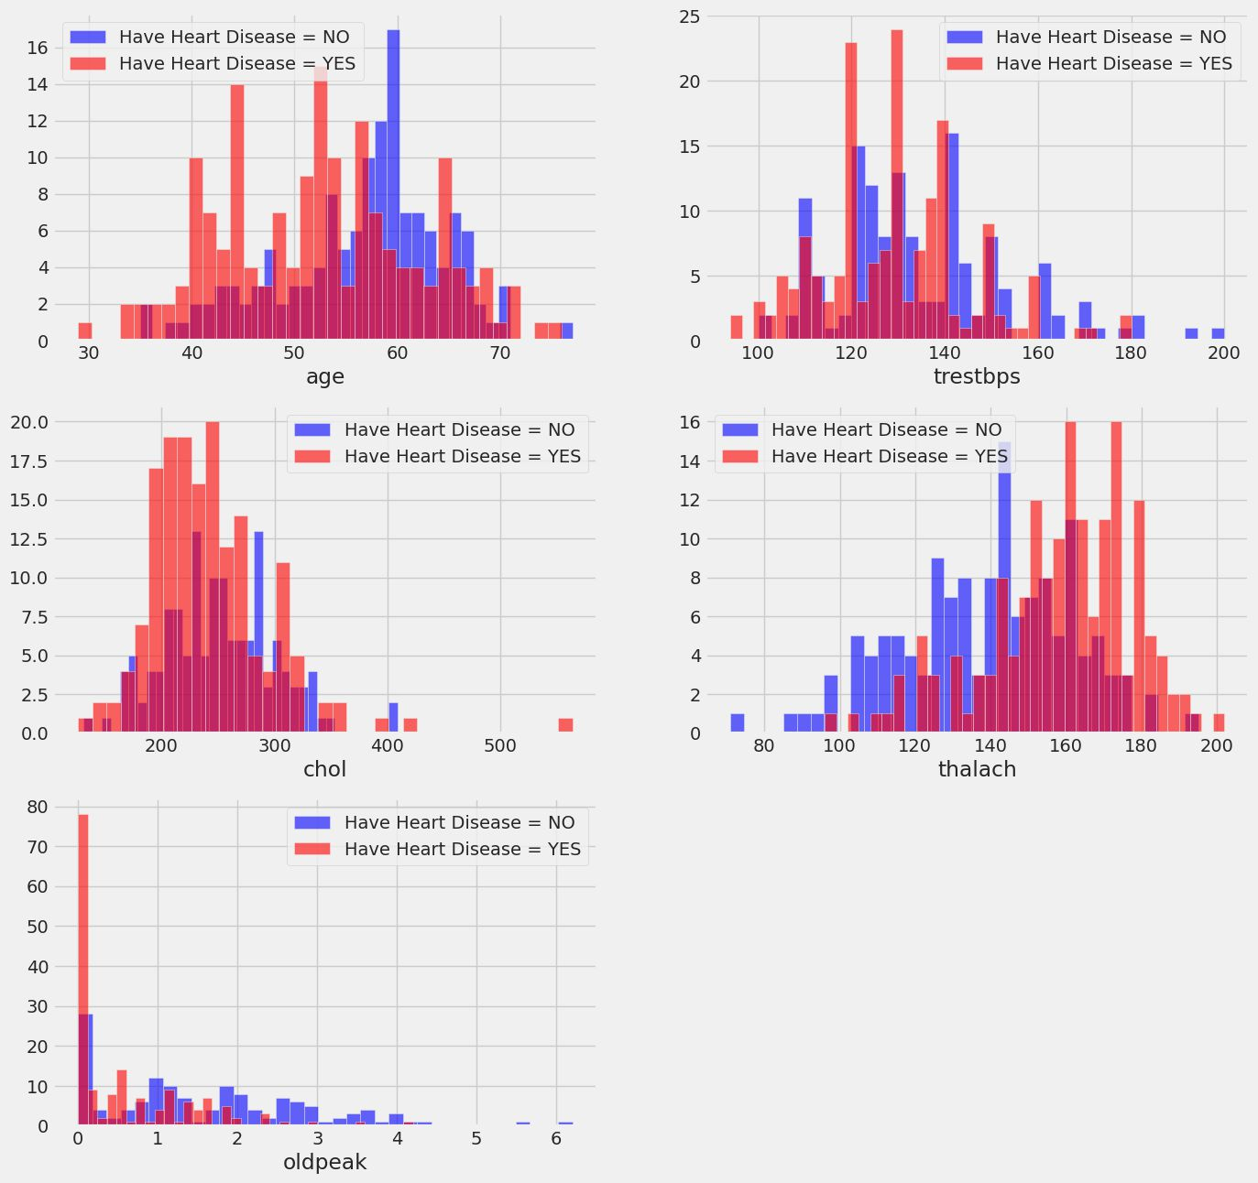

Slide 18
Observations from the above plot:
trestbps: resting blood pressure anything above 130-140 is generally of concern
chol: greater than 200 is of concern.
thalach: People with a maximum of over 140 are more likely to have heart disease.
the old peak of exercise-induced ST depression vs. rest looks at heart stress during exercise an unhealthy heart will stress more.

Slide 19
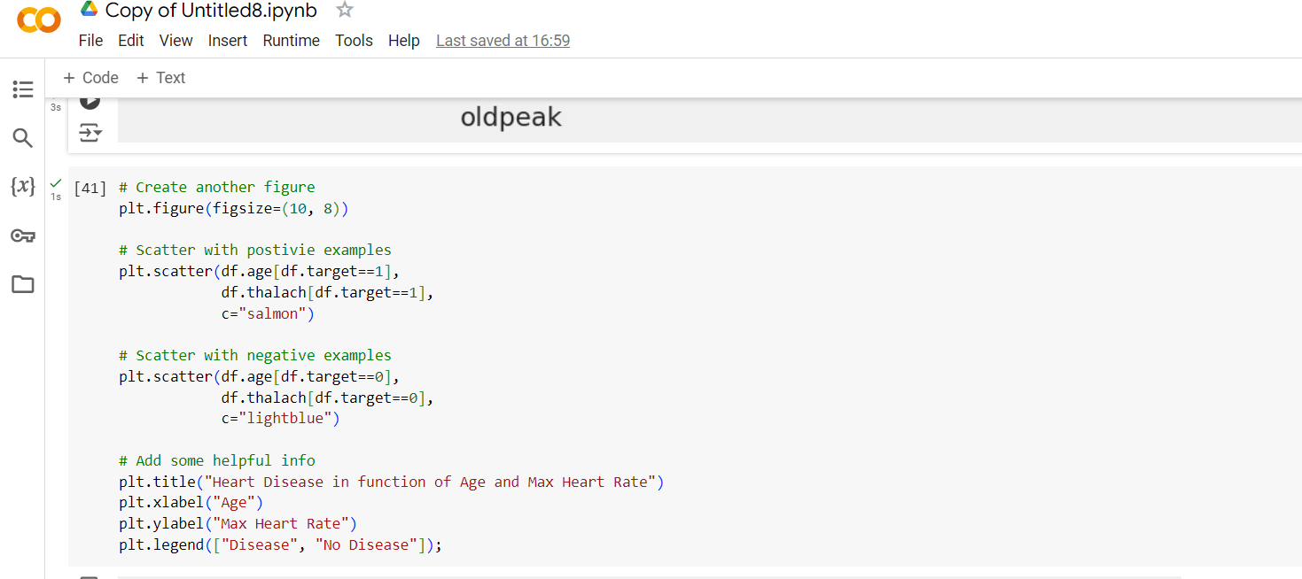
Scatter Plot

Slide 20
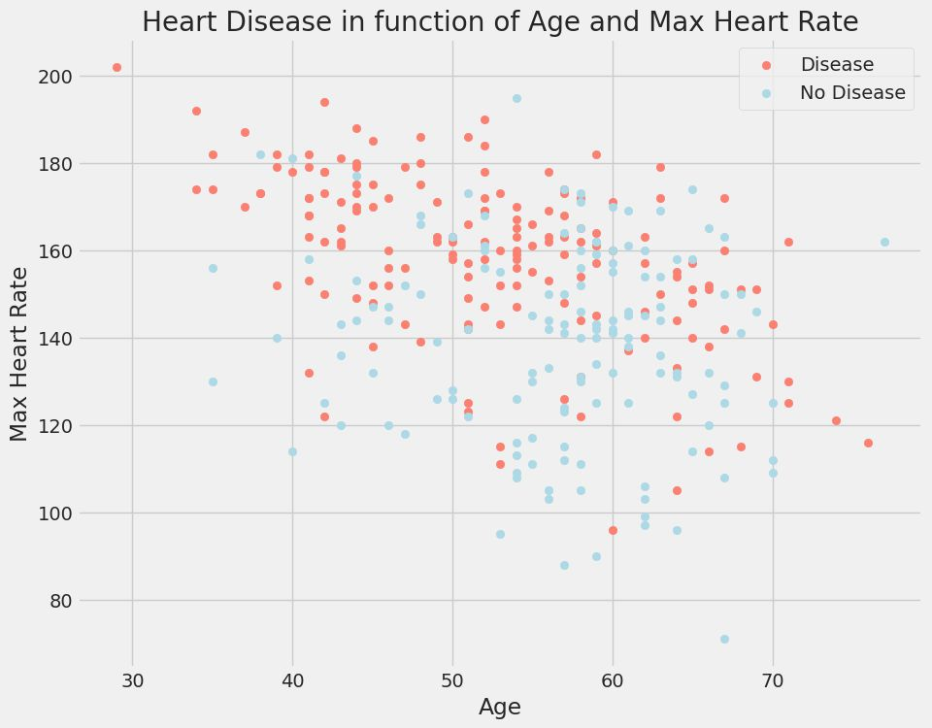

Slide 21
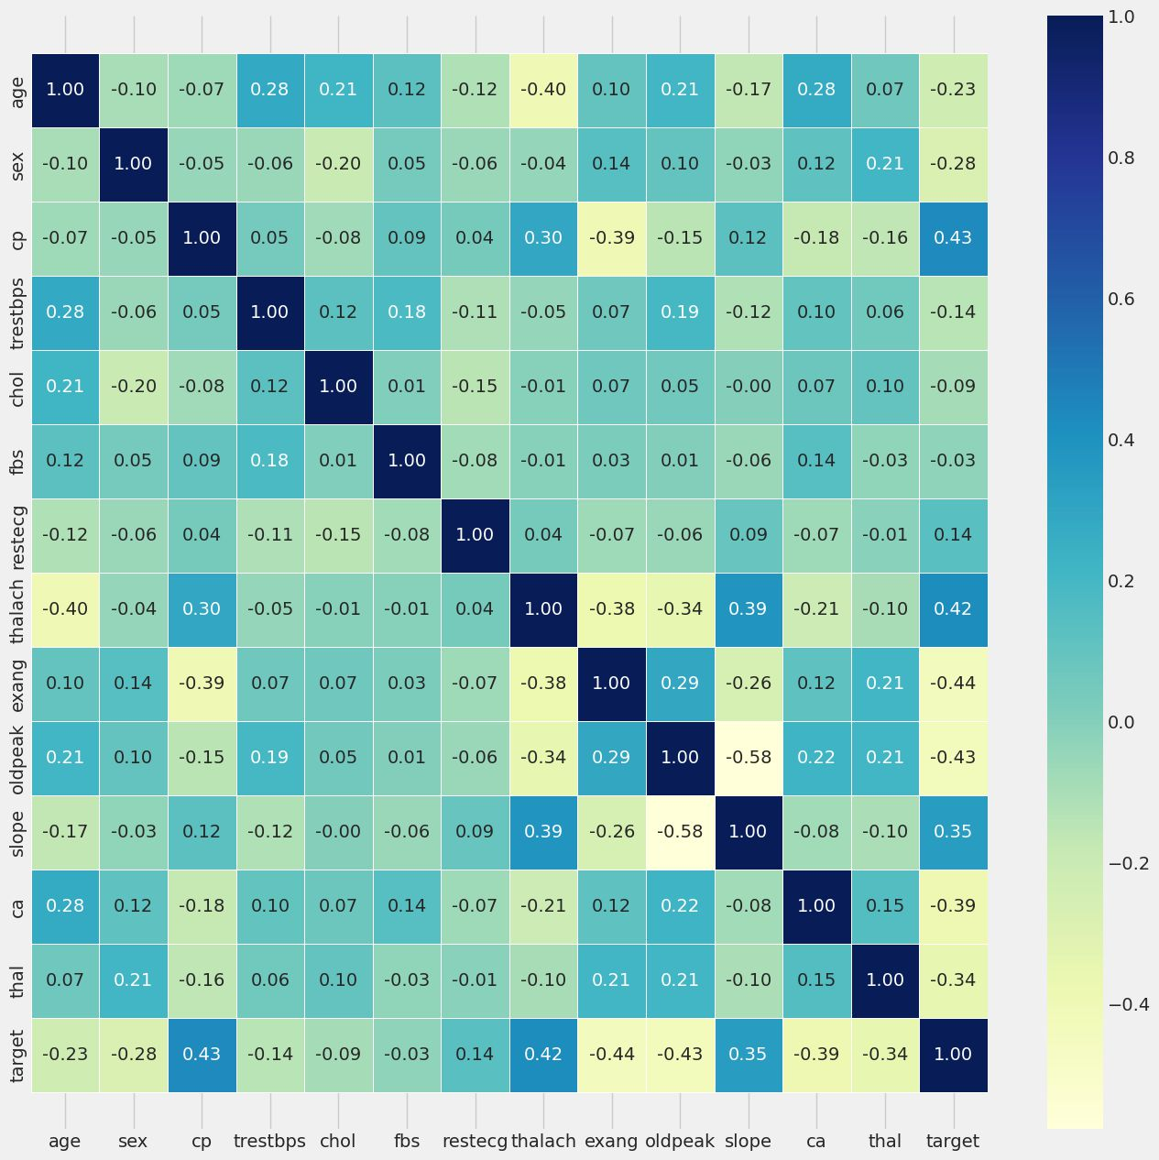
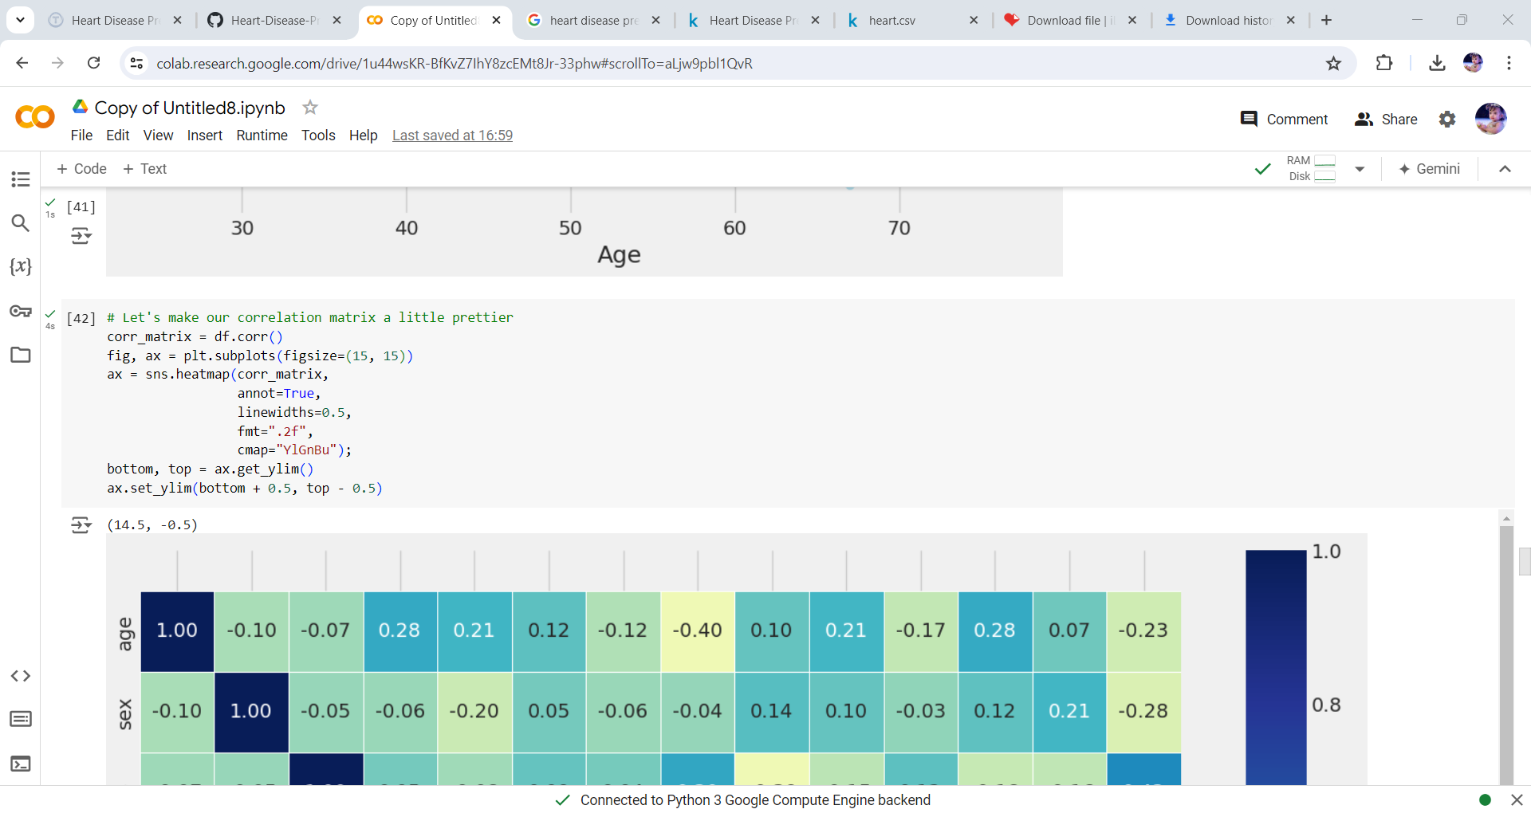
Correlation Matrix

Slide 22
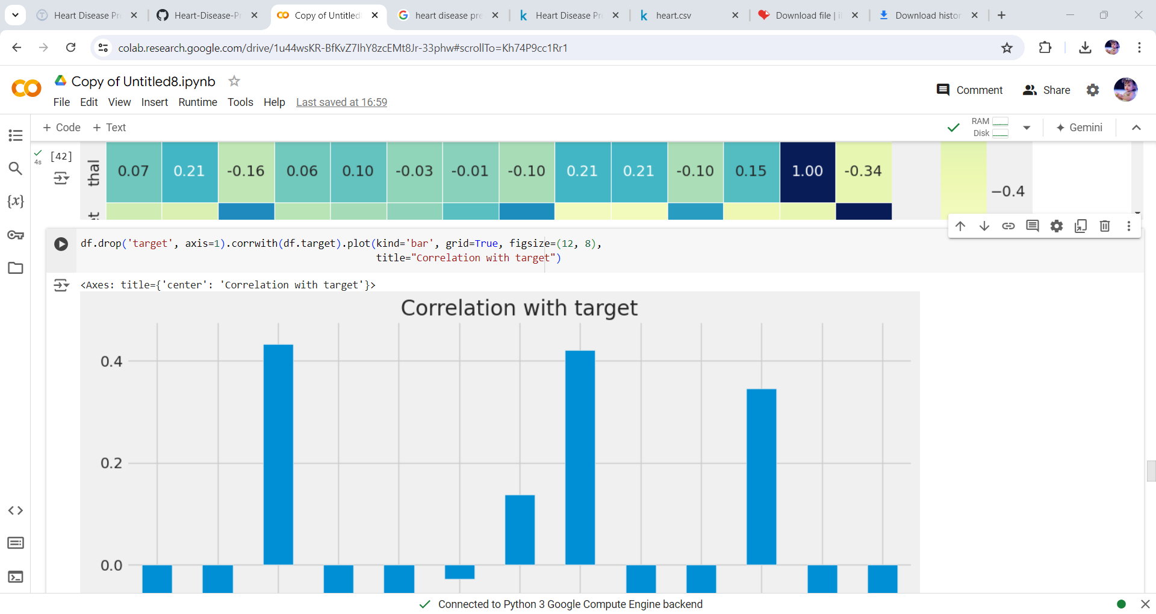
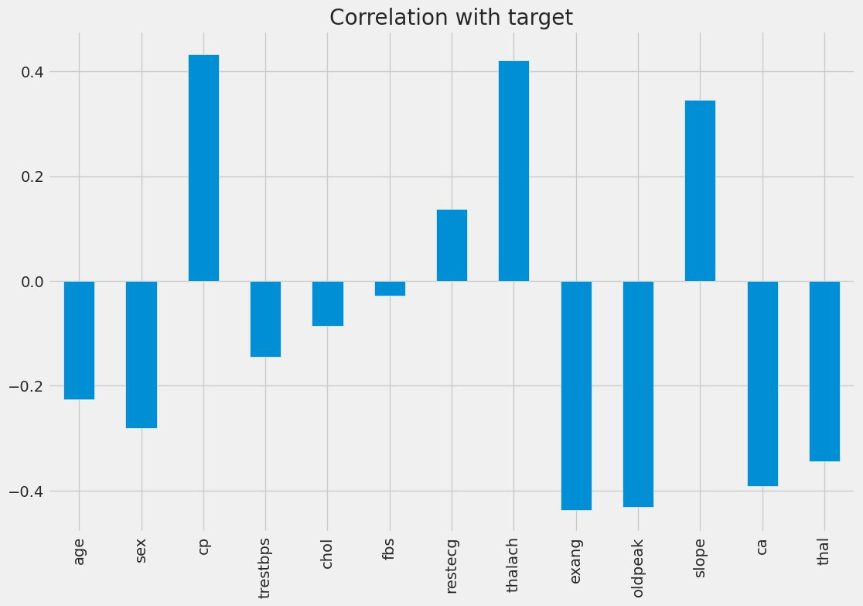

Slide 23


Slide 24
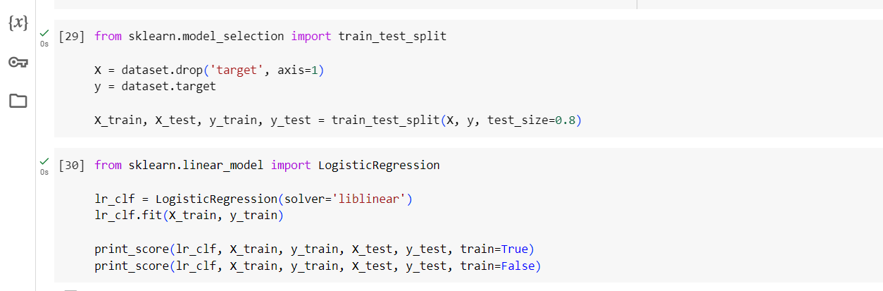
Splitting Data & Logistic Regression

Slide 25
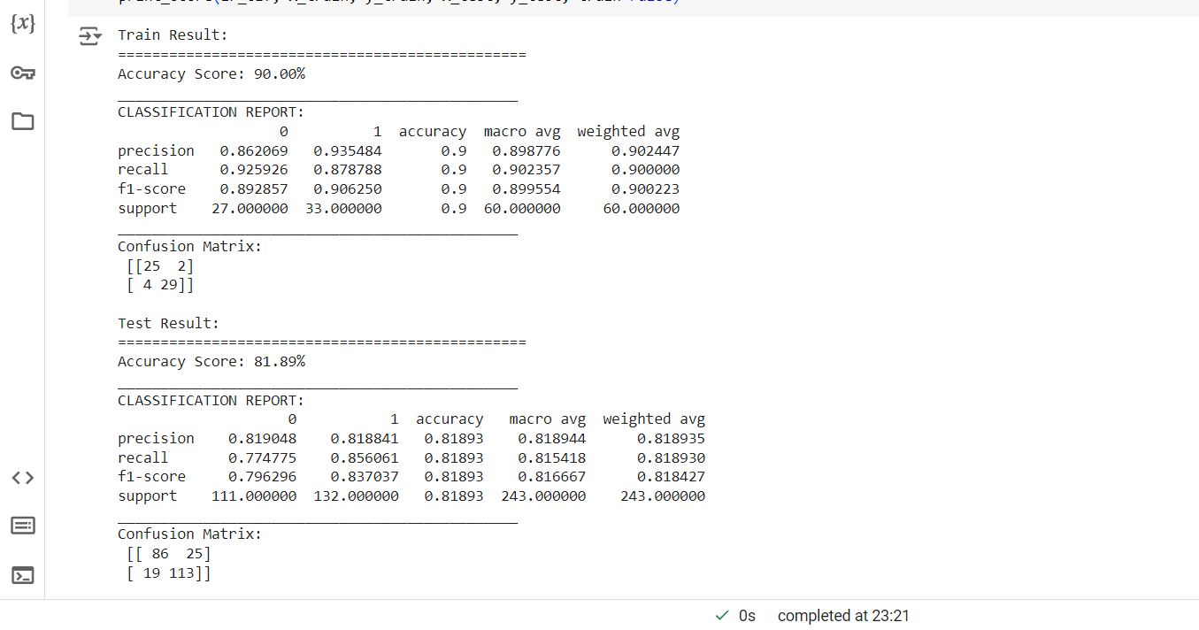

Slide 26
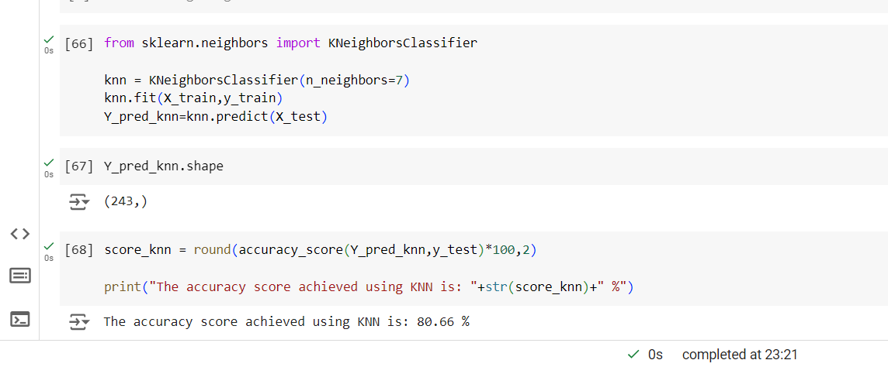
K Nearest Neighbors

Slide 27

Decision Tree

Slide 28
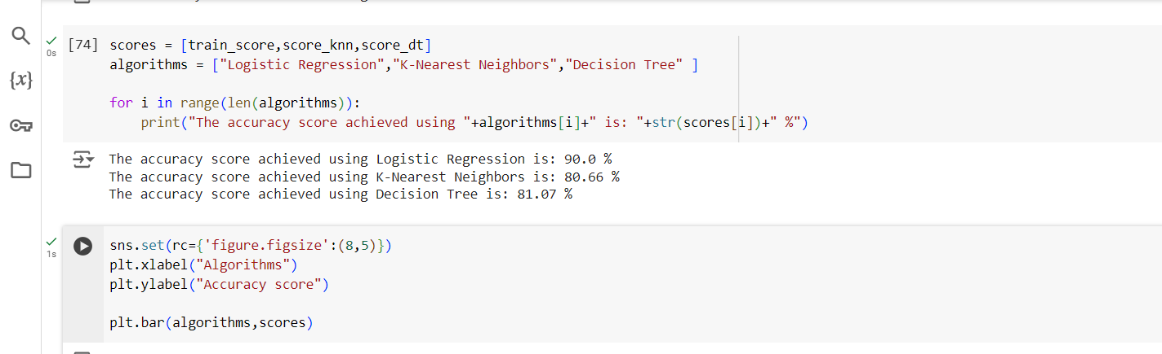
Output final score

Slide 29
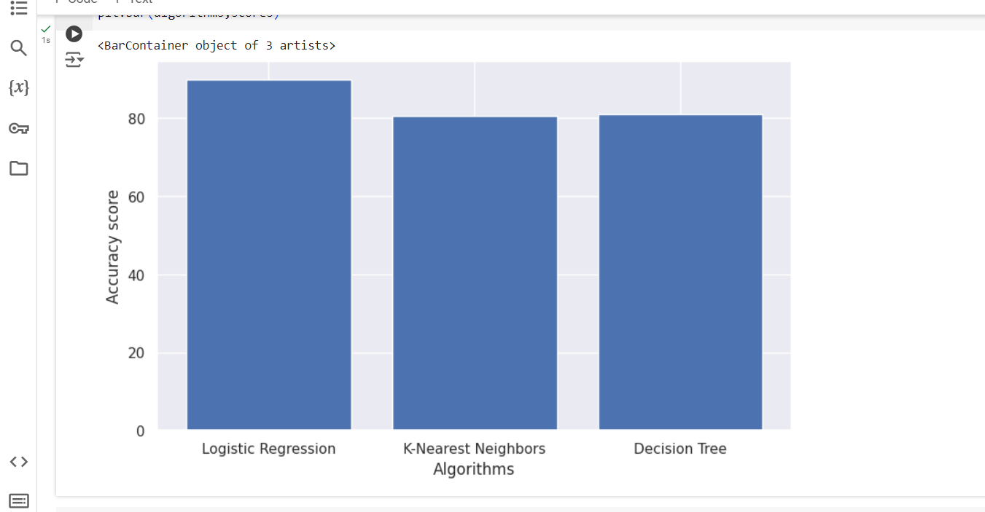

Slide 30
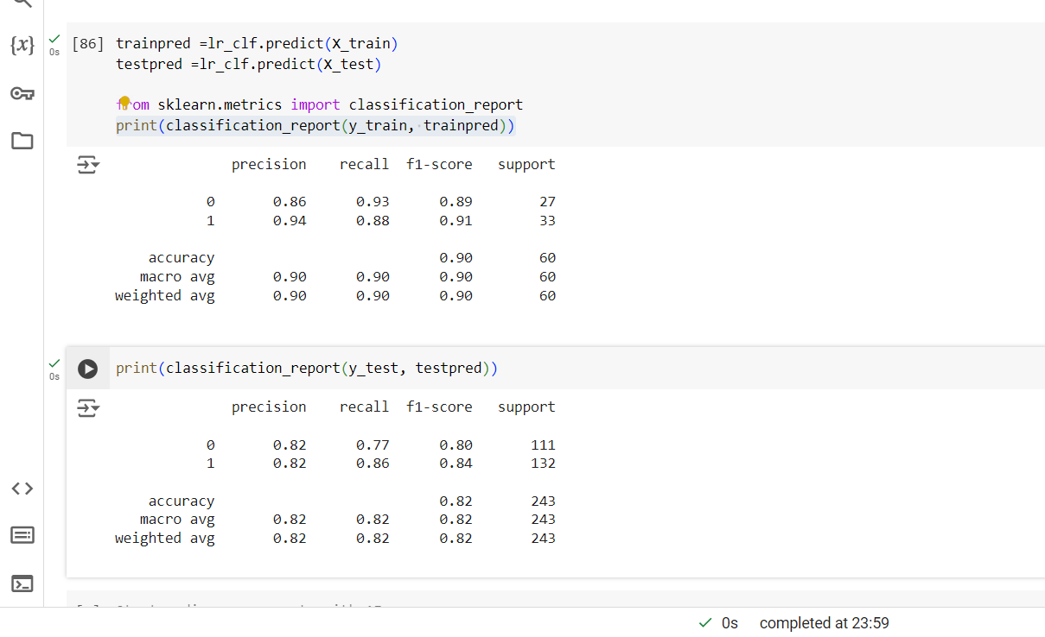
Model Evaluation

Slide 31
Conclusion:
From the results that we got, as four machine learning algorithms like Logistic Regression, K Nearest Neighbors and Decision Trees. From the final results, we got Logistic Regression as 90%, K Nearest Neighbors as 80.66% and Decision Trees as 81.02%. We can conclude that the Logistic Regression algorithm is the best algorithm for our model with the highest accuracy around 90 percent.
Finally, we can conclude that real-time predictors will be essential in the healthcare sector nowadays. From this project, we will be able to predict real-time heart disease using the patient’s data from the model using the Logistic Regression Algorithm, thereby making accurate heart disease prediction using machine learning.

Slide 32
Thank You

